Slide 1
Small Project 1
Melakukan Slicing Website Sederhana
Cilsy Fashionlution
Abdurrahman Arifin

Slide 2
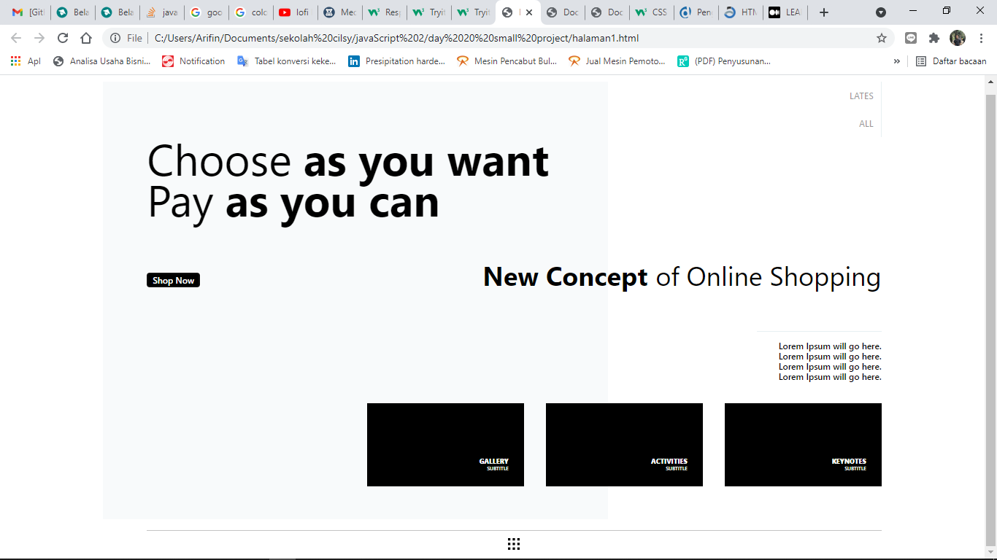
Main Page

Slide 3
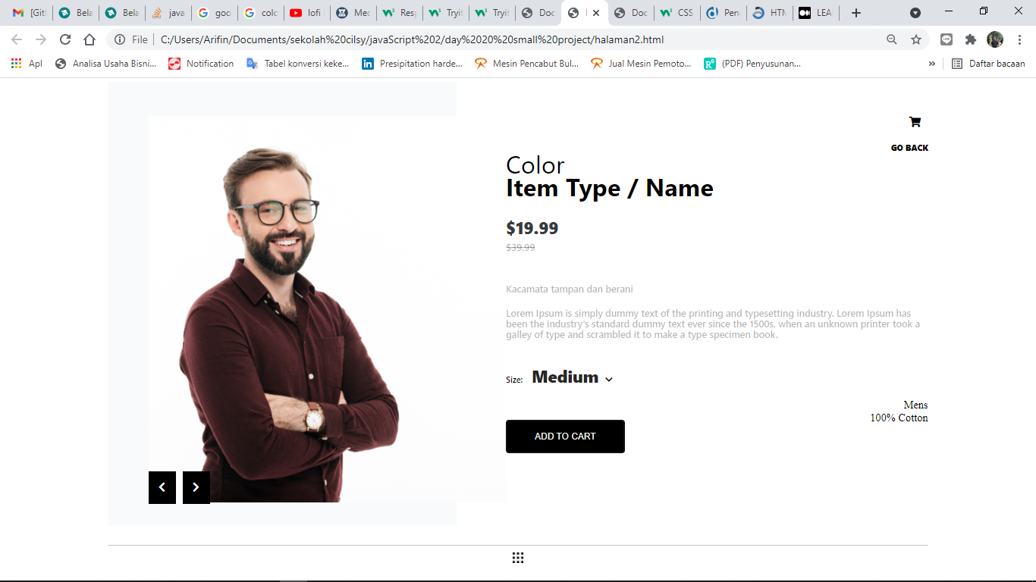
Product Page

Slide 4
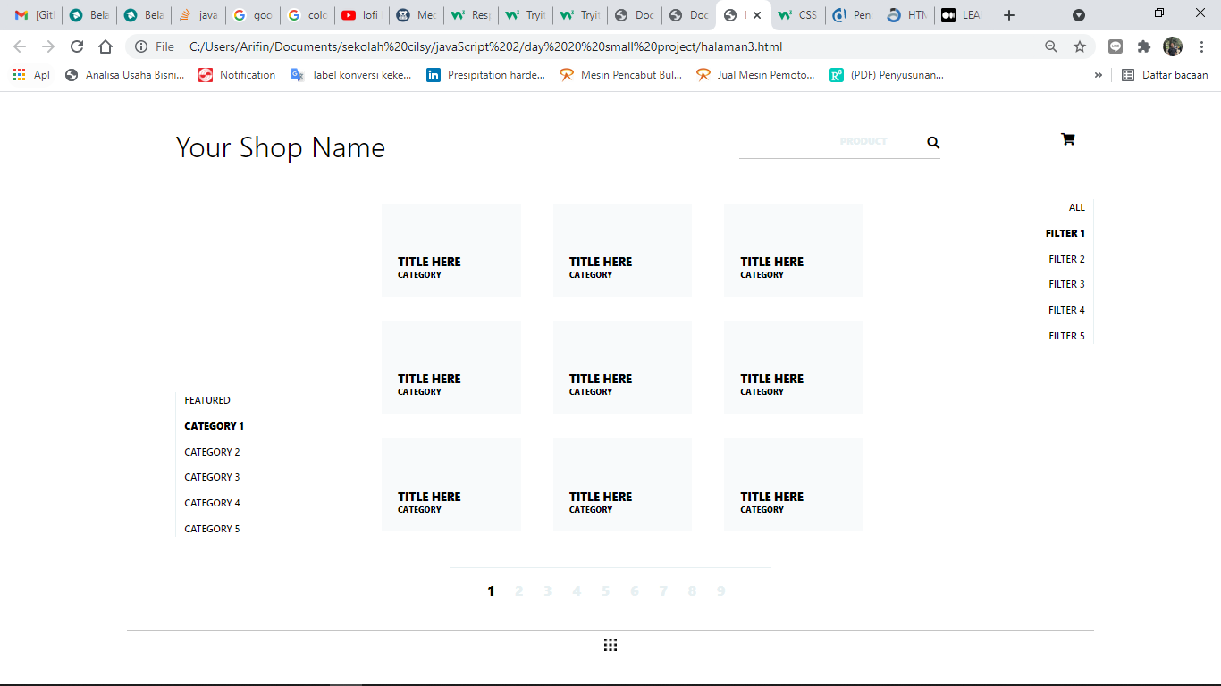
Shop Page

Slide 5
Terima kasih….

